Slide 1
Chef Provisioning
Chef Users London Meetup
Nathen Harvey - @nathenharvey
https://github.com/nathenharvey/chef-london-meetup-feb-2015

Slide 2


Nathen Harvey
nharvey@chef.io
@nathenharvey

Slide 3
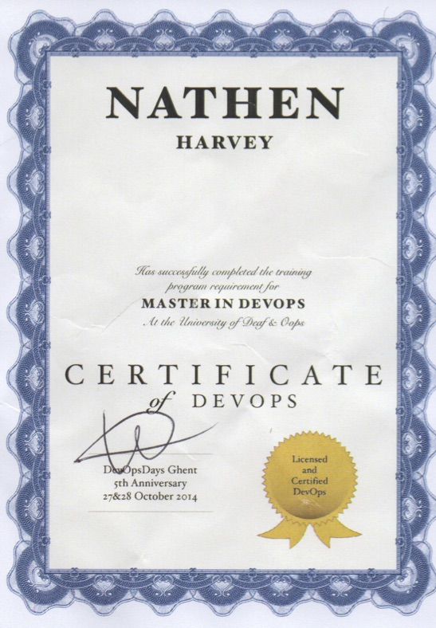
Nathen Harvey
nharvey@chef.io
@nathenharvey

Slide 4
Provisioning with Chef

Slide 5
Chef Lifecycle
Provision a server, virtual machine, or cloud instance
Install Chef
Configure Chef
Run Chef
GOTO step 4
Notes:
So we have written some Chef code, and we are eager to get it out in front of some people running in AWS. Of course the aws-cli and ec2-tools are an option for bringing the instances up, but we will still have the added step of installing Chef and getting our code on our test instances.

Slide 6
knife bootstrap
Provision a server, virtual machine, or cloud instance
Install Chef
Configure Chef
Run Chef
GOTO step 4

Slide 7
Provisioning in AWS
Let’s use AWS as our case study
We’ll look at the various ways Chef can help you provision instances there

Slide 8
knife ec2 server create -I ami-4ab46b3d -f t1.micro -g sg-884f2eed,sg-8b4f2eee --ssh-user ubuntu -N nathen_hw_knife -r "recipe[hello_world]"
ec2-54-77-67-44.eu-west-1.compute.amazonaws.com Chef Client finished, 85/149 resources updated in 38.998005693 seconds
Instance ID: i-80d76866
Flavor: t1.micro
Image: ami-4ab46b3d
Region: eu-west-1
Availability Zone: eu-west-1a
Security Groups: default
Security Group Ids: sg-884f2eed, sg-8b4f2eee
Tags: Name: nathen_hw_knife
SSH Key: chef-nathenharvey-eu
Root Device Type: ebs
Root Volume ID: vol-602e1f7c
Root Device Name: /dev/sda1
Root Device Delete on Terminate: true
Public DNS Name: ec2-54-77-67-44.eu-west-1.compute.amazonaws.com
Public IP Address: 54.77.67.44
Private DNS Name: ip-172-31-2-160.eu-west-1.compute.internal
Private IP Address: 172.31.2.160
Environment: _default
Run List: recipe[hello_world]

Slide 9

knife ec2 server create

Slide 10

knife ec2
“Infrastructure as Command Line” instead of “Infrastructure as Code”
What if I want many instances?
What if I want multiple tiers of instances?
https://flic.kr/p/eycPj7

Slide 11
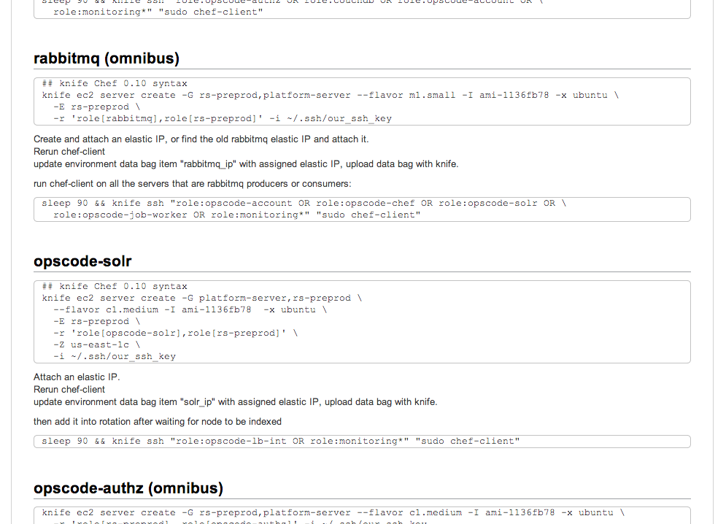
The classic operations playbook
Notes:
Those of us that have done operations and development should be familiar with the classic playbook for spinning up infrastructure. step-by-step instructions to be followed to bring your servers online. If you were lucky they existed someplace like a wiki, or document repository, but more often than not they might be in some notebook, or on the back of napkin somewhere
and remembering all of those commands is not easy...well it isn’t easy for me

Slide 12
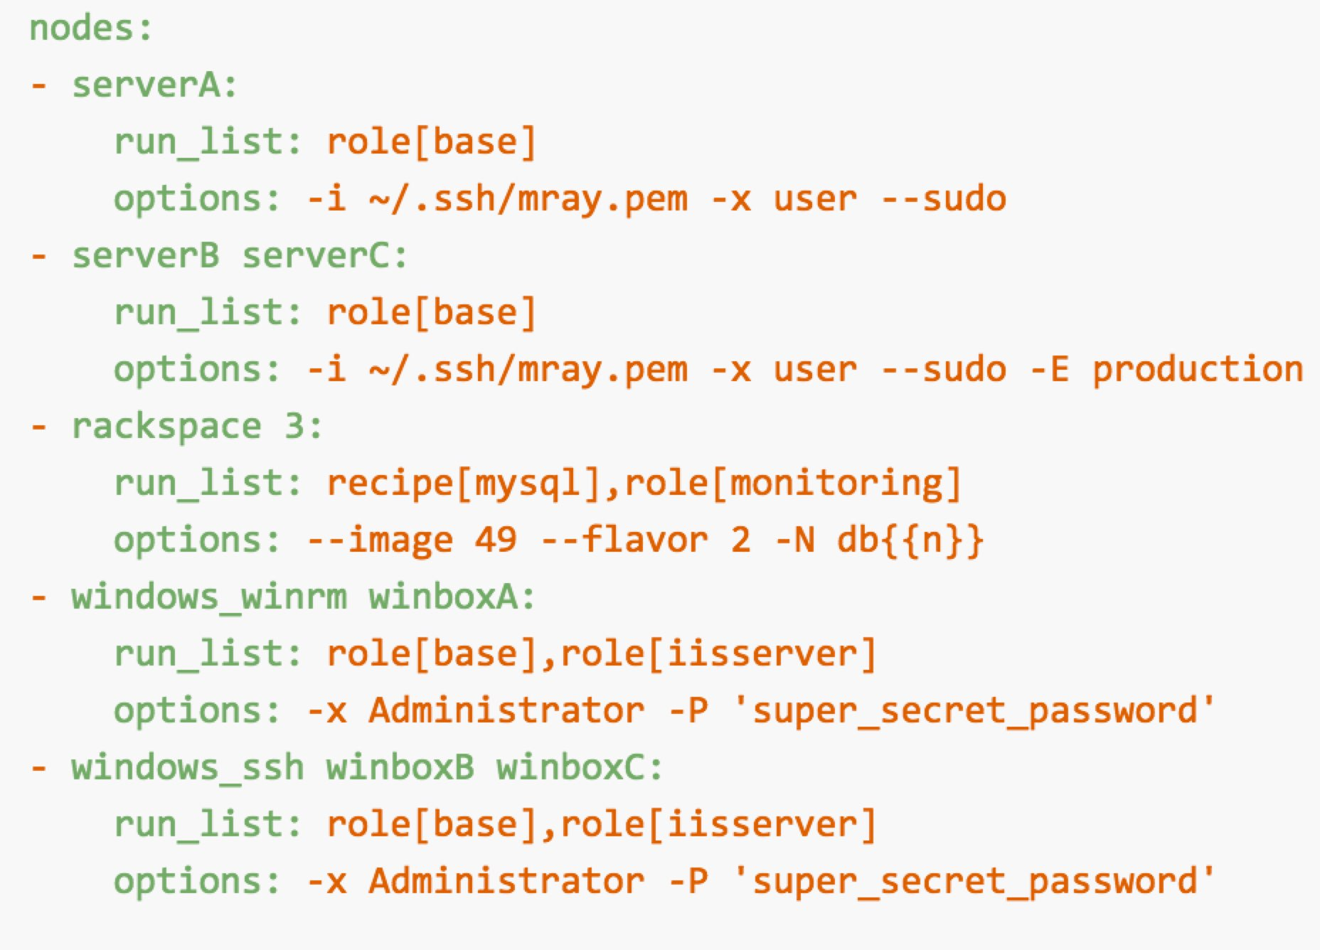
Spiceweasel
Command-line tool for batch loading Chef infrastructure
Generate and executes knife commands
https://github.com/mattray/spiceweasel
Notes:
Better but still lots of issues, including that you need to learn a new tool, new syntax, etc.

Slide 13

Chef Provisioning
Allows creation of instances in Chef Recipes
Allows for more programmatic creation
Allows for multiple tiers to be created in one shot
Moves more towards “Infrastructure as Code”
https://flic.kr/p/knDPjc

Slide 14
Chef Provisioning
machine ‘web1’ do
recipe ‘apache’
end

Slide 15
Chef Provisioning - Drivers
AWS
Azure
Fog
Vagrant
Docker
LXC
Hanlon
…and more
machine ‘web1’ do
recipe ‘apache’
end

Slide 16
The classic operations playbook
https://flic.kr/p/eycPj7

Slide 17
Chef Provisioning
require 'chef/provisioning'
machine_batch do
machines %w(primary secondary web1 web2)
end
machine_batch do
machine 'primary' do
recipe 'initial_ha_setup'
end
end
machine_batch do
machine 'secondary' do
recipe 'initial_ha_setup'
end
end
machine_batch do
%w(primary secondary).each do |name|
machine name do
recipe 'rest_of_my_configuration'
end
end
end
Notes:
Which allows you to write a recipe like this…

Slide 18
Configure Chef Provisioning
Installed as part of Chef Development Kit
Configure AWS
Create an AWS credentials file
Gems
chef-provisioning
chef-provisioning-aws

Slide 19
AWS Credentials File
~/.aws/config
[default]
region=eu-west-1
aws_access_key_id = <AWS_ACCESS_KEY_ID>
aws_secret_access_key = <AWS_SECRET_ACCESS_KEY>

Slide 20
Simple Example
require 'chef/provisioning/aws_driver'
with_driver 'aws'
machine 'nathen_web1' do
recipe 'hello_world'
end

Slide 21
Execute the Recipe
chef-client --local-mode simple.rb
[2015-02-04T12:53:22+00:00] INFO: Started chef-zero at http://localhost:8889 with repository at /Users/nathenharvey/chef_london_users/chef-repo
One version per cookbook
[2015-02-04T12:53:22+00:00] INFO: Forking chef instance to converge...
Starting Chef Client, version 12.0.3
[2015-02-04T12:53:22+00:00] INFO: *** Chef 12.0.3 ***
[2015-02-04T12:53:22+00:00] INFO: Chef-client pid: 23233
[2015-02-04T12:53:31+00:00] INFO: Run List is []
[2015-02-04T12:53:31+00:00] INFO: Run List expands to []
[2015-02-04T12:53:31+00:00] INFO: Starting Chef Run for nharveycul215
[2015-02-04T12:53:31+00:00] INFO: Running start handlers
[2015-02-04T12:53:31+00:00] INFO: Start handlers complete.
[2015-02-04T12:53:31+00:00] INFO: HTTP Request Returned 404 Not Found : Object not found: /reports/nodes/nharveycul215/runs
resolving cookbooks for run list: []
[2015-02-04T12:53:31+00:00] INFO: Loading cookbooks []
Synchronizing Cookbooks:
Compiling Cookbooks...
[2015-02-04T12:53:35+00:00] WARN: Node nharveycul215 has an empty run list.
Converging 7 resources
Recipe: @recipe_files::/Users/nathenharvey/chef_london_users/chef-repo/web.rb

Slide 22
Test and Repair
Resources follow a test and repair model
machine 'nathen_web1'

Slide 23
Test and Repair
Resources follow a test and repair model
machine 'nathen_web1'
Test
nathen_web1 exist?
Yes

Slide 24
Test and Repair
Resources follow a test and repair model
machine 'nathen_web1'
Test
nathen_web1 exist?
Yes
Done

Slide 25
Test and Repair
Resources follow a test and repair model
machine 'nathen_web1'
Test
nathen_web1 exist?
Yes
No
Done

Slide 26
Test and Repair
Resources follow a test and repair model
machine 'nathen_web1'
Test
nathen_web1 exist?
Yes
No
Done
Create it

Slide 27
Test and Repair
Resources follow a test and repair model
machine 'nathen_web1'
Test
nathen_web1 exist?
Yes
No
Repair
Done
Create it

Slide 28
Behold! The power of a loop
Need multiple instances?
That’s easy!
num_webservers = 3
(0...num_webservers).each do |i|
machine "nathen_web_0#{i}" do
recipe "hello_world"
end
end

Slide 29
More with AWS
Security Groups
Elastic Load Balancers
VPCs
Auto Scaling Groups
SQS Queues
…and more
https://github.com/chef/chef-provisioning-aws

Slide 30
Security Group
with_data_center 'eu-west-1' do
aws_security_group "nathen-provisioning-security-group" do
inbound_rules [
{:ports => 22, :protocol => :tcp, :sources => ["0.0.0.0/0"] },
{:ports => 80, :protocol => :tcp, :sources => ["0.0.0.0/0"] }
]
end
end

Slide 31
Security Groups
{
"id": "nathen-provisioning-security-group",
"security_group_id": "sg-1d452878"
}
Information is stored in data bag items

Slide 32
Load Security Group ID
security_group = data_bag_item('aws_security_groups',
'nathen-provisioning-security-group')
security_group_id = security_group['security_group_id']

Slide 33
Use the Security Group
with_machine_options :bootstrap_options => {
:instance_type => 't1.micro',
:security_group_ids => [security_group_id]
}

Slide 34
Elastic Load Balancer
load_balancer "nathen-elb" do
load_balancer_options :availability_zones => ['eu-west-1a', 'eu-west-1b', 'eu-west-1c'],
:listeners => [{
:port => 80,
:protocol => :http,
:instance_port => 80,
:instance_protocol => :http,
}]
machines machine_names
end

Slide 35
Provisioning Production Environments

Slide 36

Chef Provisioning – Provisioning Node
Chef Server
AWS

Slide 37
Chef Provisioning – Provisioning Node
Chef Server
$ knife ec2 server create \
--node-name provisioner-node-1 \
--run-list “recipe[provision]”, “recipe[provision::orchestration]”
AWS

Slide 38
Chef Provisioning – Provisioning Node
Chef Server
provisioner-node-1
$ knife ec2 server create \
--node-name provisioner-node-1 \
--run-list “recipe[provision]”, “recipe[provision::orchestration]”
AWS

Slide 39
Chef Provisioning – Provisioning Node
Chef Server
provisioner-node-1
$ knife ec2 server create \
--node-name provisioner-node-1 \
--run-list “recipe[provision]”, “recipe[provision::orchestration]”
AWS

Slide 40
Chef Provisioning – Provisioning Node
require 'chef/provisioning'
machine_batch do
machines %w(primary secondary web1 web2)
end
machine_batch do
machine 'primary' do
recipe 'initial_ha_setup'
end
end
machine_batch do
machine 'secondary' do
recipe 'initial_ha_setup'
end
end
machine_batch do
%w(primary secondary).each do |name|
machine name do
recipe 'rest_of_my_shit'
end
end
end
Chef Server
provisioner-node-1
AWS

Slide 41
Chef Provisioning – Provisioning Node
primary
secondary
web1
web2
require 'chef/provisioning'
machine_batch do
machines %w(primary secondary web1 web2)
end
machine_batch do
machine 'primary' do
recipe 'initial_ha_setup'
end
end
machine_batch do
machine 'secondary' do
recipe 'initial_ha_setup'
end
end
machine_batch do
%w(primary secondary).each do |name|
machine name do
recipe 'rest_of_my_shit'
end
end
end
Chef Server
provisioner-node-1
AWS

Slide 42
Chef Provisioning – Provisioning Node
primary
secondary
web1
web2
Chef Server
provisioner-node-1
AWS

Slide 43
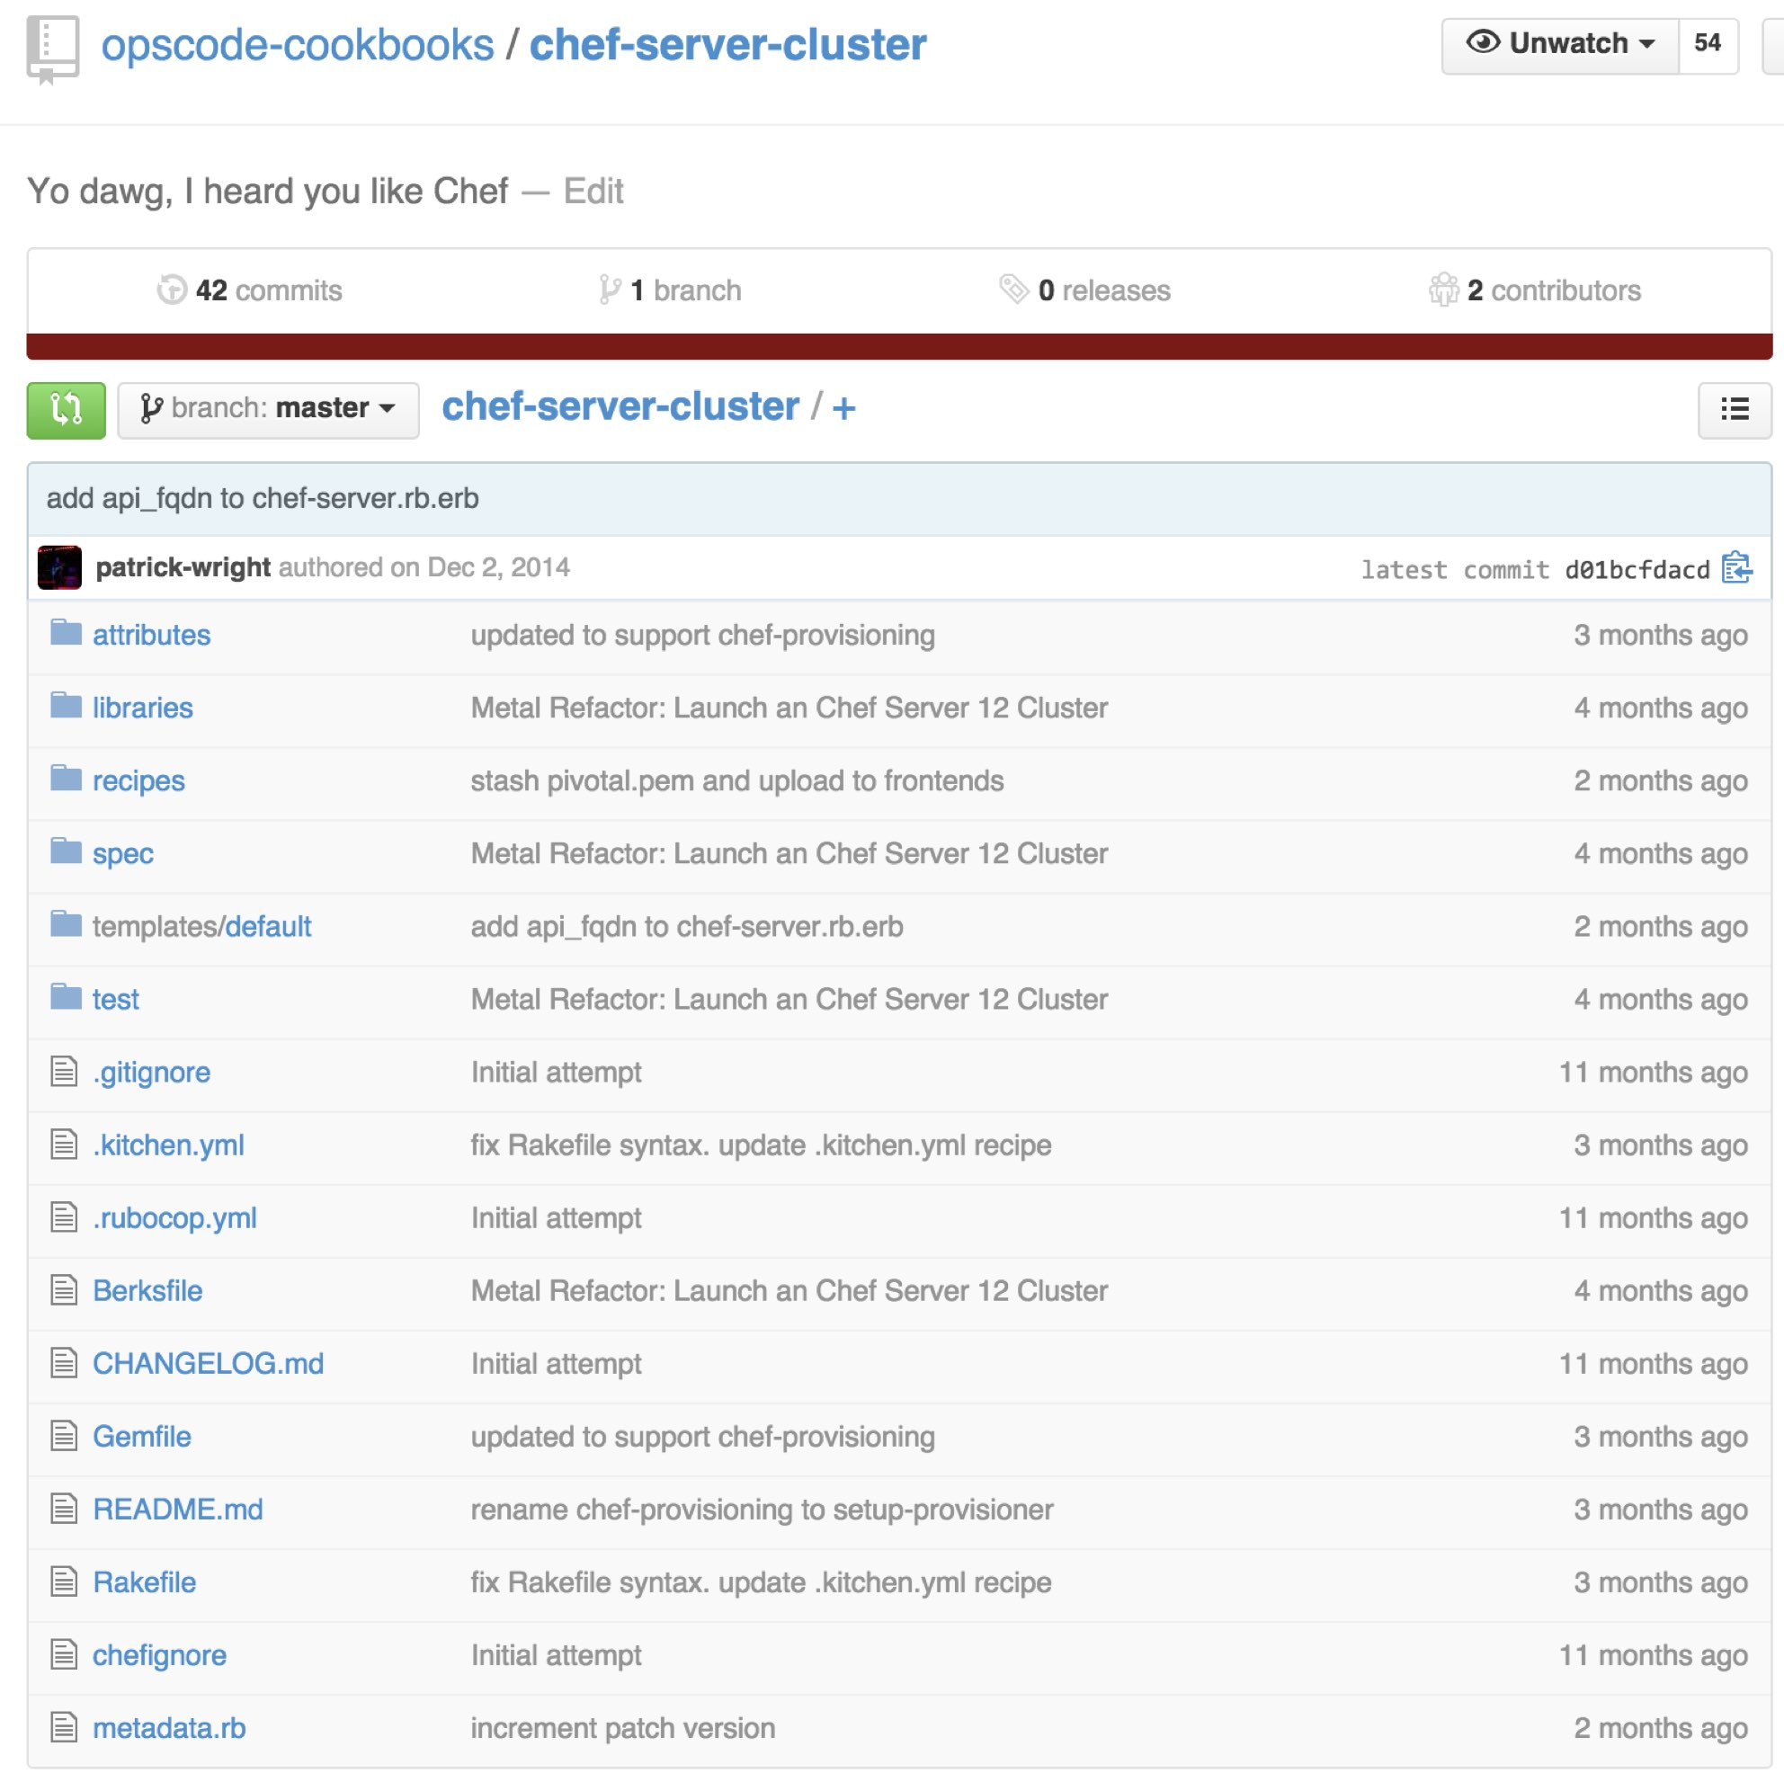
chef-server-cluster
chef-server-cluster Cookbook
Built On chef-provisioning
Stand up Chef Server 12 AWS in a tiered configuration
Stand up Analytics
https://github.com/opscode-cookbooks/chef-server-cluster

Slide 44
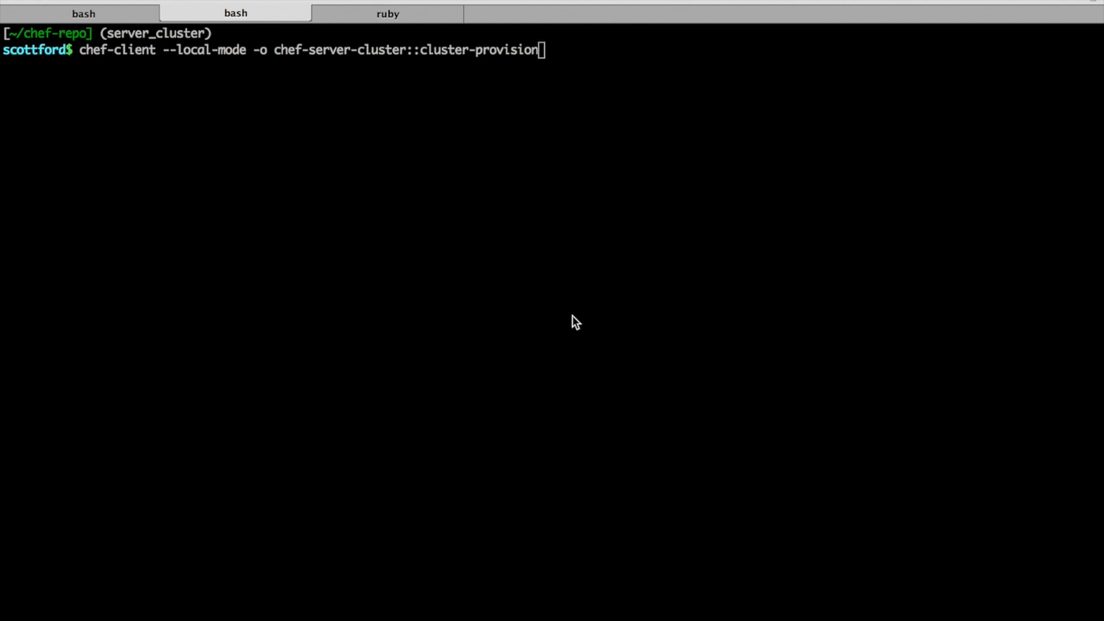
Chef Provisioning – chef-server-cluster
Notes:
And we are already starting to see very creative useage of chef-provisioning

Slide 45
Chef Provisioning Recap
Machine resource for creating instances
Drivers for many providers
Programmatically declare your infrastructure as code
Testable
Repeatable
Notes:
Tiered is sufficient to test performance because even in HA, only one backend is active at any time anyways, so the performance would be the same.
Backend tuning used:
PostgreSQL max connections = 1500
Erchef:
depsolver_worker_count = 4
depsolver_timeout = 120000
db_pool_size = 100
AuthZ:
http_init_count = 100
http_max_count = 100
Bifrost:
db_pool_size = 100
Certificate:
Num_workers = 4
Max_certificates_per_worker = 1000
For specific tuning guidance for each customer, discuss with success engineering.

Slide 46
What’s on the horizon?
Version 1.0 coming soon!
IAM Roles support
More resources…
Notes:
Tiered is sufficient to test performance because even in HA, only one backend is active at any time anyways, so the performance would be the same.
Backend tuning used:
PostgreSQL max connections = 1500
Erchef:
depsolver_worker_count = 4
depsolver_timeout = 120000
db_pool_size = 100
AuthZ:
http_init_count = 100
http_max_count = 100
Bifrost:
db_pool_size = 100
Certificate:
Num_workers = 4
Max_certificates_per_worker = 1000
For specific tuning guidance for each customer, discuss with success engineering.

Slide 47
How you can contribute
Use it
Fork the repositories
Write new drivers
Add resources
Open issues
Notes:
Tiered is sufficient to test performance because even in HA, only one backend is active at any time anyways, so the performance would be the same.
Backend tuning used:
PostgreSQL max connections = 1500
Erchef:
depsolver_worker_count = 4
depsolver_timeout = 120000
db_pool_size = 100
AuthZ:
http_init_count = 100
http_max_count = 100
Bifrost:
db_pool_size = 100
Certificate:
Num_workers = 4
Max_certificates_per_worker = 1000
For specific tuning guidance for each customer, discuss with success engineering.

Slide 48
Where to go from here
Chef-provisioning https://github.com/chef/chef-provisioning
Chef-provisioning-aws https://github.com/chef/chef-provisioning-aws
Gitter IM Channel https://gitter.im/chef/chef-provisioning
Notes:
Some examples of CloudFormation templates, updated for Chef Server 12, are in https://github.com/opscode/chef-server-cloudformation-templates
Writing a CFN template for HA is much trickier so I haven't done it yet. You need to attach the data volume EBS to the primary, LVM/format it as part of the build of the PrimaryBackend, so we can't declare the VolumeAssociation as a separate element.
CloudFormation is also useful for orchestrating the correct installation order:
- Bootstrap backend server first
- Put bootstrap data in autocreated S3 bucket
- Autoscaling group for N frontends
- Each frontend on bootup grabs backend data from S3, then does p-c-c reconfigure
You can eliminate bookshelf entirely and configure erchef to serve cookbooks out of S3

Slide 49
What Questions Do You Have?
https://github.com/nathenharvey/chef-london-meetup-feb-2015

